Slide 1
Location TVM
Final Project

Slide 2
Team
Achraf KASSIMI
Hassan EL FAQIR
Yassine TALEB

Slide 3
Brief Description
The latest software engineering project in our group 19 called "LOCATION TVM" is a website that allows users to save money and time, and we are carefully served to ensure the convenience we offer for the perfect transfer solution tailored to your needs.
Notes:
أحدث مشروع لهندسة البرمجيات في مجموعتنا 19 يسمى «LOCITE TVM» هو موقع ويب يسمح للمستخدمين بتوفير المال و الوقت، ويتم خدمتنا بدقة لضمان الراحة التي نقدمها لحل النقل المثالي المصمم خصيصًا لاحتياجاتك.

Slide 4
Technologies
Front-end: HTML, CSS, JavaScript, Bootstrap, React
Back-end: Phyton, Flask, SQLAlchemy,API

Slide 5
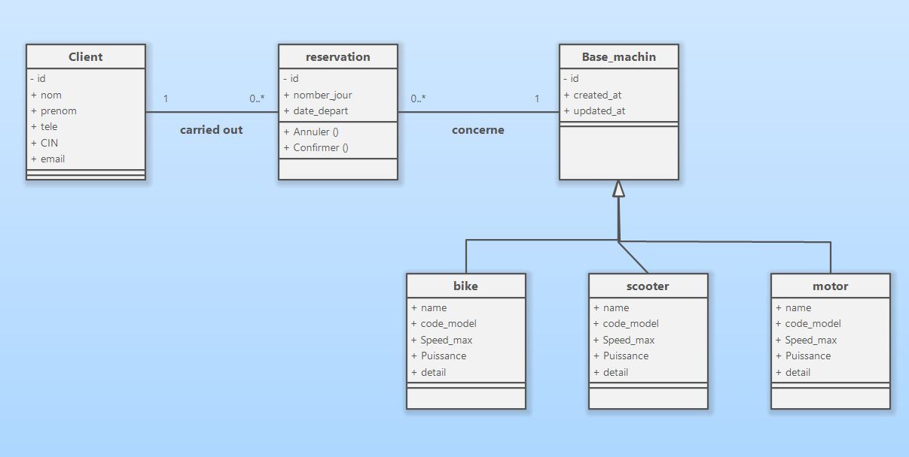
ARCHITECTURE

Slide 6
Designing a website for a Location TVM Tracking System involves multiple elements and layers, each fulfilling a distinct function.
Front-End (Client-Side):
This is the client-side interface of the application, where users engage with the Location TVM tracker.
Frameworks/Libraries: React.js for developing an interactive and adaptive user interface.
Components:
Data Entry Forms: data entry forms such as personal information, booking, number of days or hours.
User Authentication: Login and registration forms, password reset functionality.

Slide 7
2. Back-end (Server-Side):
This component of the application manages data processing, business logic, and interactions between the frontend and the database.
Framework: Python with Flask
API Layer: RESTFul APIs or GraphQL, Cors, Crypto for handling requests from the frontend.
Authentication: JWT (JSON Web Tokens) or OAuth2 for user authentication and authorization.

Slide 8
Business Logic:
- Validation and processing of data.
- Tracking goals and calculating progress.
- Scheduling and managing notifications.

Slide 9
3. Third-Party Integrations:
To enhance functionality, the web app can integrate with various third-party services.
APIs:
Fitness Trackers: (Fitness API, Google APIs, People APIs).
Sleep Trackers.
Payment Gateways: For subscription services or premium features (e.g. Google pay).

Slide 10
4. DevOps and Deployment:
Ensuring the application is reliably deployed and maintained.
Github Actions for continuous integration and deployment.

Slide 11
Report on our progress, detailing accomplishments, problems improvements, lessons learned, and next steps.
1. Accomplishments:
Detail completed tasks, milestones reached, and key achievements.
Include any successful implementations, features, or improvements made.
2. Problems:
Outline any issues or obstacles encountered.
Describe how these problems impacted progress and any immediate consequences.

Slide 12
3. Improvements:
Highlight areas where enhancements were made.
Explain any optimizations or upgrades implemented and their effects.
4. Lessons Learned:
Share insights gained from experiences, both positive and negative.
Discuss what was learned about processes, tools, or strategies.
5. Next Steps:
Outline the forthcoming tasks and objectives.
Define the plan for addressing unresolved issues and moving forward.

Slide 13
Challenges Already Identified:
Scalability: Ensuring the system can handle a growing number of users and rental transactions.
Real-Time Tracking: Implementing accurate GPS tracking and real-time updates.
Payment Security: Securing transactions and handling sensitive payment information.
User Experience: Designing an intuitive interface for seamless navigation and booking.
Mock-ups (if applicable):
User Interface Mock-ups: Provide visual designs for the user dashboard, booking screens, and rental options.
System Flow Diagrams: Illustrate the flow of data and interactions between the front-end, back-end, and external services.

Slide 14
Summary of our Experience
The Location TVM project has advanced significantly since its start. Despite encountering numerous challenges, the team has successfully overcome them and achieved meaningful progress. With a clear vision for future development and deployment. Location TVM is poised to become a valuable resource for users aiming to enhance their mobility, save money, and promote environmental conservation.

Slide 15
Thank you
- ALX - Foundation
- Alx_africa
- Cohort 19 Mentors

